Slide 1
Tips for Effective Meeting Management
Gideon St Bryce
Adventist Community Service workshop
2023

Slide 2
There are three critical sets of persons at any meeting.
1 The chairperson
2 The scribe or secretary
3 Members
None of these are more important than the other, they all play indispensable roles. We will, however, pay particular attention to the role of the chairperson but will also look at the other roles.

Slide 3
Having the three components, then require
PURPOSE: A clear objective.
PREPERATION: A structured agenda.
PROGRESS: The right people involved.
PARTICIPATION: Material/Info available.
PROCESS: Established rules of conduct
THE 5 Ps

Slide 4
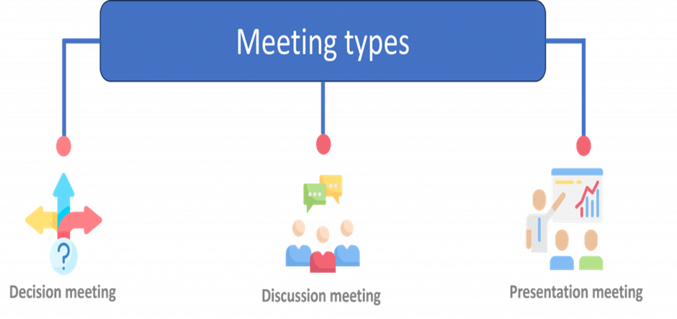
What Type / Nature of the Meeting
Each has a different goal and requires a specific approach
.

Slide 5
Elements for efficacy
Comfortable Ambience: Space management
Psychological Safety. Free and comfortable to share.
Time Management: Time to end is not whenever you finish.
Sharing Not Debating: They are not the same.
Give members a voice: Not to just have their say.
Follow through: If not it’s just a talk shop

Slide 6
Useful Terminology

Slide 7
Useful Terminology

Slide 8
Useful Terminology
Seconder Someone who formally supports the mover of a motion.
Point of Order A formal complaint (to the chairperson) at a meeting that a speaker is being irrelevant, unduly repetitive, exceeding prescribed time, speaking out of turn or in some way violating standing orders.
. Procedural motion A motion aimed at changing the sequence or timing of events at a meeting, rather than one which addresses an agenda item.
Adopt—to accept something.
Standing committee—a group that is a permanent part of the organization.

Slide 9
Useful Terminology
Unfinished business—issues that weren’t decided at the last meeting but were postponed to this one.
New business—the current issues to be discussed at the meeting.
Entertain a motion—the Chair asks if anyone wants to discuss a certain issue.
Make a motion (“I move that...”, or "I so move.")—a member of the meeting presents an issue to be discussed.
Second a motion (“I second the motion”; or just “second.”)—another member agrees the issue should be discussed.
Have the floor—a member is permitted to speak, after being “recognized” by the Chair.
Table a motion—put the issue aside to talk about something more important before going back to the main issue.

Slide 10
Useful Terminology
Vote “aye” (sounds like “eye”) meaning yes or “nay”—meaning no. Another way to say it is to “vote up or down” (yes or no respectively).
Motion carried—the motion succeeded.
Adjourn—to take a break during the meeting; or to end a meeting that happens regularly, so you’re actually “taking a break” until next month or even the next year, depending on when the next meeting will be held.
Privileged motions are motions that are unrelated to the current motion but are of such urgency or importance that they are considered immediately. These motions are related to members, the organization, and meeting procedure rather than the item of business being considered.

Slide 11
Chairperson as a facilitator
Good listening and communication skills are at the core of good facilitation. This helps us build trust and openness in the group, understand each other, and ultimately, come up with better decisions. It is important for a facilitator to develop these skills - but everyone can help the meeting along by practising them too.
Put simply:
Active listening enables us to hear what others are saying;
Questioning helps clarify what people are saying or supports people to explore their needs and come up with new possibilities.
Summarising helps remind us of the key points in the discussion and check we have the same understanding.
Synthesising is the skill that allows us to draw together different views and ideas to form one proposal that works for everyone.

Slide 12
Points on how to deal with conflict in the boardroom
Conflict between board members is quite common.
Not all board conflict leads to damage and trouble.
Left unaddressed, relationship conflict escalates and can damage a board’s ability to make good decisions.
Effective governance requires an open attitude toward a potential conflict.
Good corporate governance emerges from an awareness that dissent needn’t mean division.
How to share a framework that embraces disagreement

Slide 13
THE END.
Thank You!
Questions ?

